Slide 1
CSL7090 Software & Data Engineering
Lecture #12 NoSQL, Graph, XML, Key-Value Store
Course Instructors:
Sumit Kalra, Assistant Professor, IIT Jodhpur
Ram Subramaniam, Co-founder - My Money Karma
Google Classroom Code: dyplagt

Slide 2
Limitations of Relational Databases
Inadequate representation of data
Semantic Overloading
Weak support for recursion
Homogeneous structure of all the records - rigid schema
Short-lived transactions
Non-versioned data

Slide 3
Additional Challenges
Complexity
Schema Independence
Sparseness
Self-descriptiveness
Variability
Scalability
Volume

Slide 4
NOSQL
Not Only SQL
Data models others than conventional relational schema
Support flexible schema structure
May not facilitate ACID (in particular Consistency)

Slide 5
Graph Databases
Addresses Semantic Overloading problem of relational databases
Entities - Nodes/Vertices
Relations - Arcs/Edges
Can store information in Nodes as well as in Edges
Eg. Social Networks, Geographical Information
Types: Simple undirected graph, simple directed graph, undirected multigraph, directed multigraph, weighted graphs
Traversal: Eulerian Path/Cycle, Hamiltonian Path/Cycle

Slide 6
Graph Data Structures
Edge List
Adjacency Matrix
Incidence Matrix
Adjacency List
Incidence List

Slide 7
Some more pointers on graph databases
Property Graph Model
A multi-relational graph, Nodes and Edges can be of different types
Advanced Graph Models
Hypergraph, Nested graph
Example Systems
Apache TinkerPop, Neo4J, HyperGraphDB, and many more . . .

Slide 8
XML
eXtensible Markup Language
Standards: XML Schema, XQuery, XSLT
Semi-structured Schema, tree shape
XML Document, Document Type Definition, XML Schema Definition, XML Parsers
XML Query Languages: XPath, XQuery (FLOWER expression)
XSLT - eXtensible Stylesheet Language Transformation
XML Concurrency Control: Node-locking, Path-Index-Locking
Example Systems: eXistDB, BaseX, and manay more

Slide 9
Key-Value Store
Schemaless database
A powerful framework for scalable and distributed processing: Map-Reduce
4 basic operations:
Split: split key-value pairs in disjunct subsets
Map: execute map function on key-value pairs, outputs intermediate k-v pairs
Shuffle: group intermediate k-v pairs based on key
Reduce: reduce value for each group to usually one key-value pair

Slide 10
Map-Reduce Example
Counting words in a document:
Split - Input: document, Output: sentences
Map - Input: sencetens, Output: (word, 1)
Shuffle - Input: (word, 1), Output: (word, 1:1:1:1…)
Reduce - Input: (word, 1:1:1:1…), Output: (word, SUM(1:1:1:1…))

Slide 11
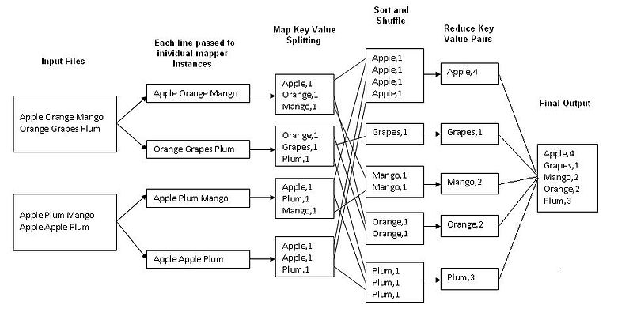

Slide 12
?
Any Questions?

Slide 13
Homework:
Try transferring data from SQL to NoSQL system and vice-versa
Next Class: Setting up DB on cloud. Flask API framework for Python - Dr. Ram
Contact: sumitk@iitj.ac.in

